Slide 1
Load Balancing
Lecturer: Ngo Huy Bien
Software Engineering Department
Faculty of Information Technology
VNUHCM - University of Science
Ho Chi Minh City, Vietnam
nhbien@fit.hcmus.edu.vn

Slide 2

Objectives
To implement load balancing for a distributed system.

Slide 3

Contents
Solving a Problem
Task: Load Balancing
Scalability Concepts
Routing Requests Methods
Routing Requests using Nginx
Routing Requests using haproxy
Application State Management
Application Data Files Management
Application Databases Management

Slide 4

References
Valeria Cardellini et al. (1999). Dynamic Load Balancing on Web-Server Systems.
Jeffrey Dean and Luiz Andre Barroso (2013). The Tail at Scale.

Slide 5

Solving a Problem: The Hard Part
Input:
Story: As sponsors, we want the system to be able to run on 2 web servers so that we can serve as many customers as we want.
Developer: Ngo Huy Bien.
Bonus:
UI + Architecture.
Scenarios, Domain Models + ERD.
Prototype + Proof of Concept
Output:
Source code → Problem solved.
Issue: Which tools? I haven't used these tools.

Slide 6


Why Learn a New Tool?
1
Make money
Get a job (job requirement)
Startup (solving a problem)
Tool selection
Faster development (Get a task done).
Easier modifiability and extensibility.
Better security and scalability.
Hobby
Problem/need.
Open yourself up to new ideas and approaches.
2

Slide 7


Identify a Concrete Problem
Configure load balancing for api using nginx.
Configure load balancing for api using haproxy.

Slide 8

Typical Procedure
Clarify domain-specific terminologies (Load balancing? nginx?, haproxy)
Find a tutorial (or a mentor).
Install, configure and use the tool.
Test results.

Slide 9


Slide 10
Why Load Balancing?
Abstraction (Simplicity for clients)
Performance
Fault tolerance (Single point of failure)

Slide 11
Distributed Web-Server System [1]
A distributed Web-server system is any architecture consisting of multiple Web-server hosts, distributed on LANs and WANs, with a mechanism to spread incoming client requests among the servers.
Each server in the system can respond to any client request.
Information can be distributed among server nodes in two ways:
content tree replication on a server’s local disk, or
information sharing by means of a distributed file system.

Slide 12
How to Route Requests?
Method 1: Let users manually select alternative URLs for a Web site.
Method 2: Use web clients. Web clients, if they are aware of the Web-server system’s replicated servers, can actively route requests.
Method 3: Use smart clients. Smart client is downloaded from a Web server and can automatically update itself.
Method 4: Use DNS name servers.
Method 5: Use a dispatcher (load balancer).

Slide 13
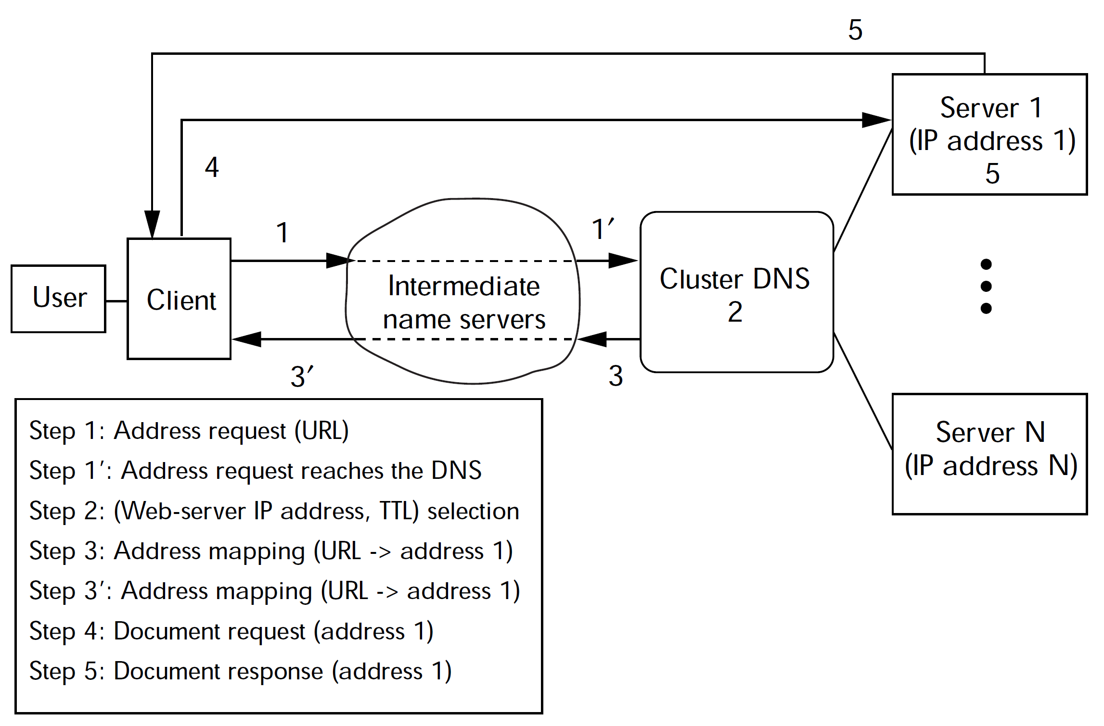
DNS-Based Approach

Slide 14
Dispatcher-Based Approach
To centralize request scheduling and completely control client-request routing, a network component of the Web-server system acts as a dispatcher.
Request routing among servers is transparent— unlike DNS-based architectures, which deal with addresses at the URL level, the dispatcher has a single, virtual IP address (IP-SVA).
The dispatcher uniquely identifies each server in the system through a private address that can be at different protocol levels, depending on the architecture.
We differentiate dispatcher-based architectures by routing mechanism—packet rewriting (single-rewriting or double-rewriting), packet forwarding, or HTTP redirection.

Slide 15
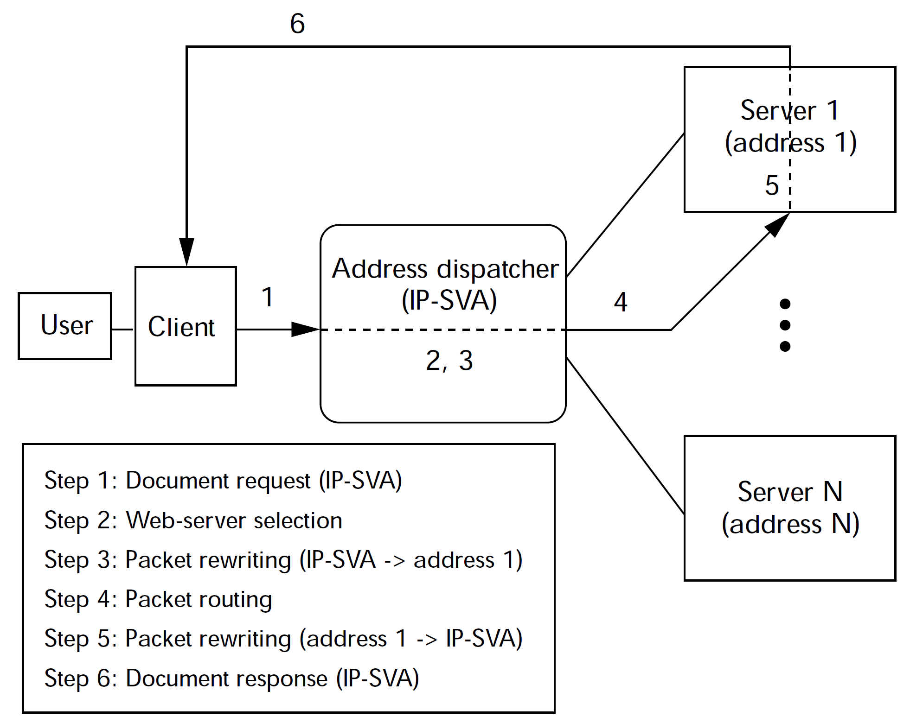
Packet Single-Rewriting

Slide 16
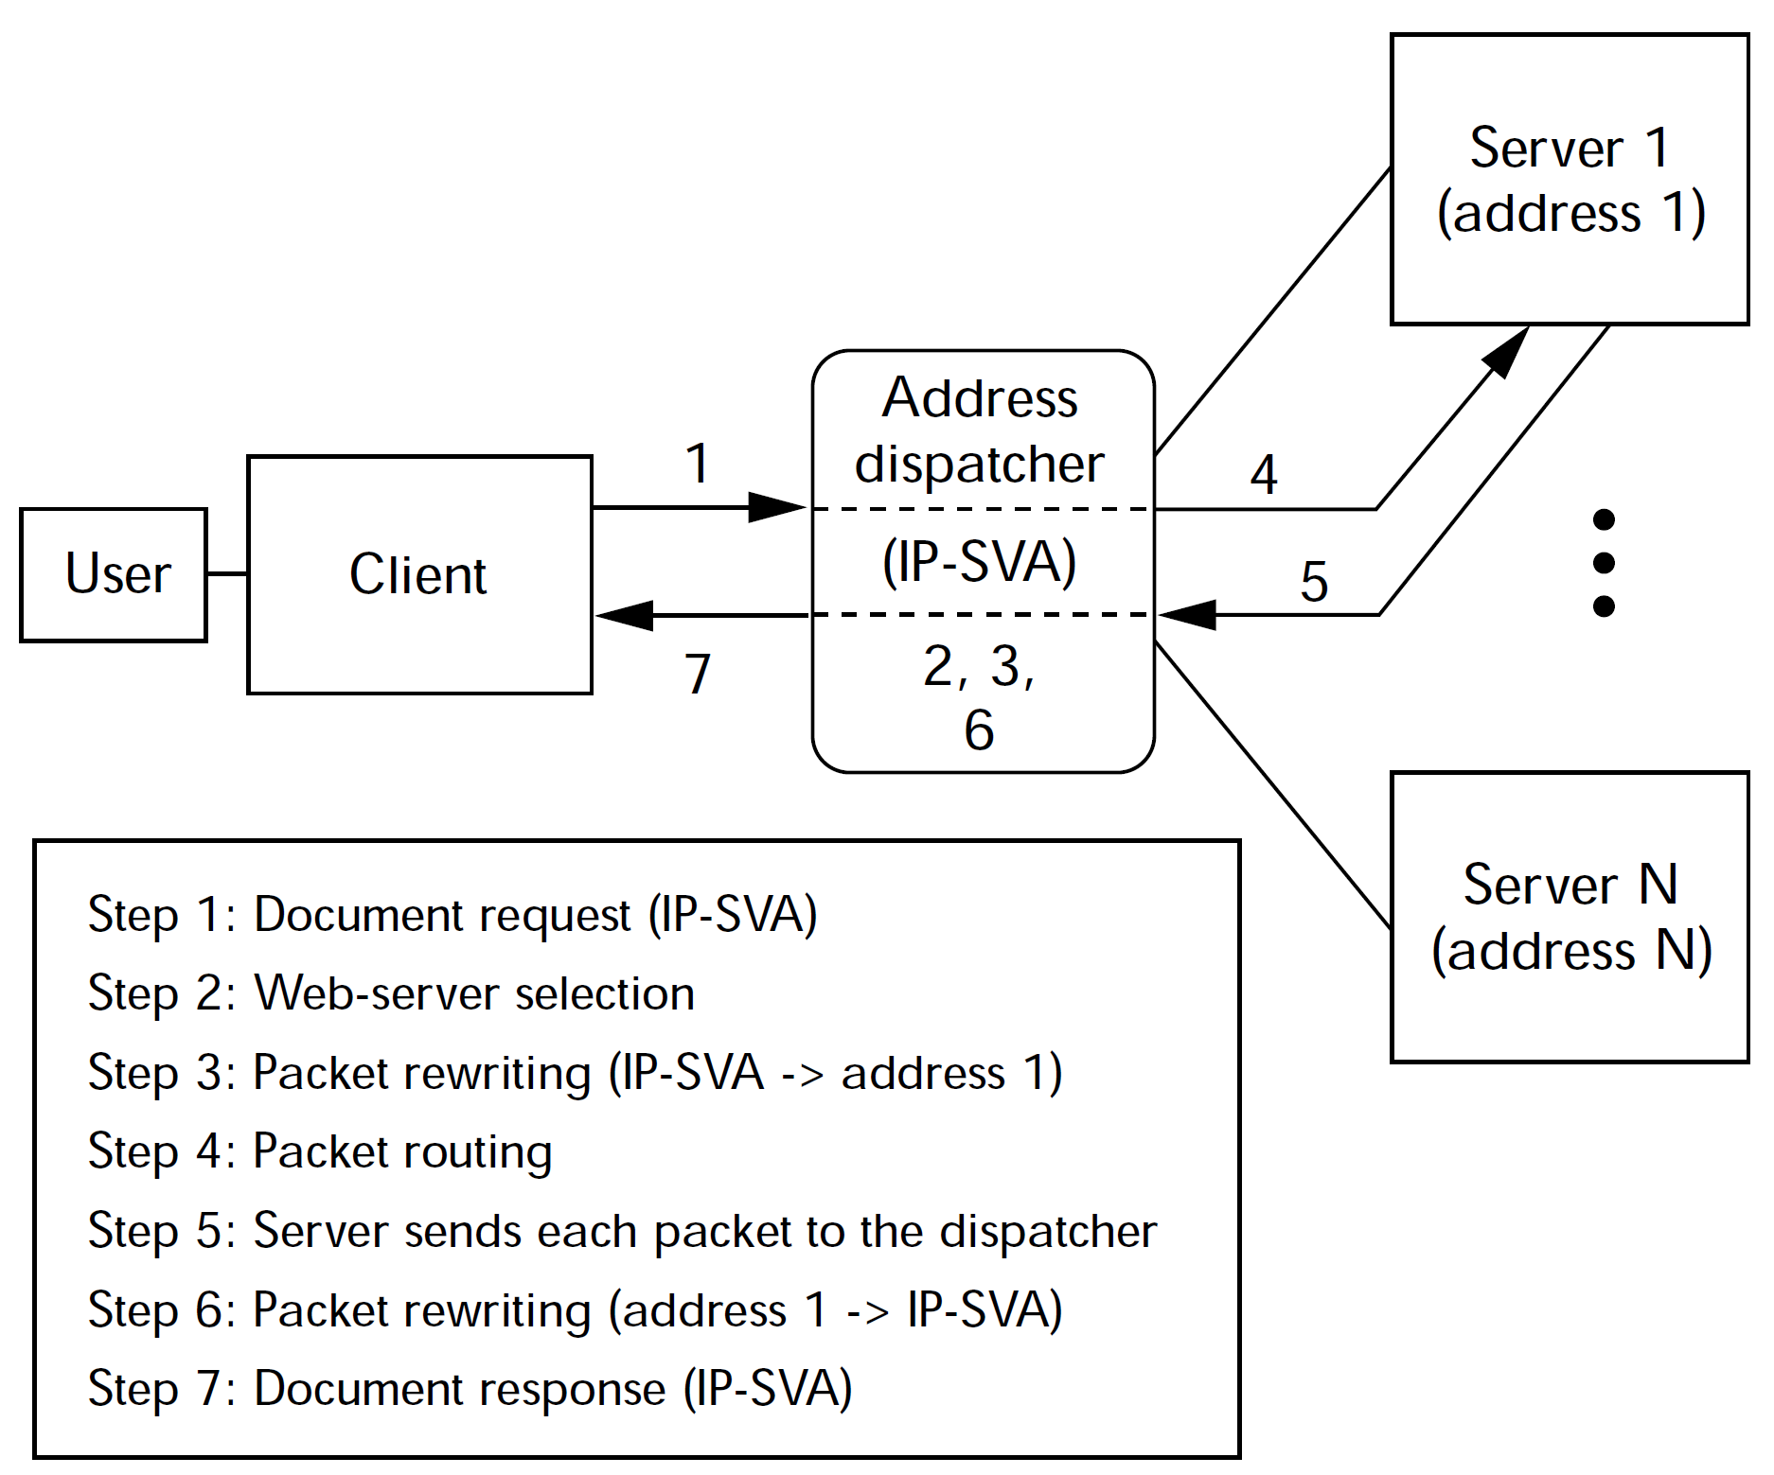
Packet Double-Rewriting

Slide 17
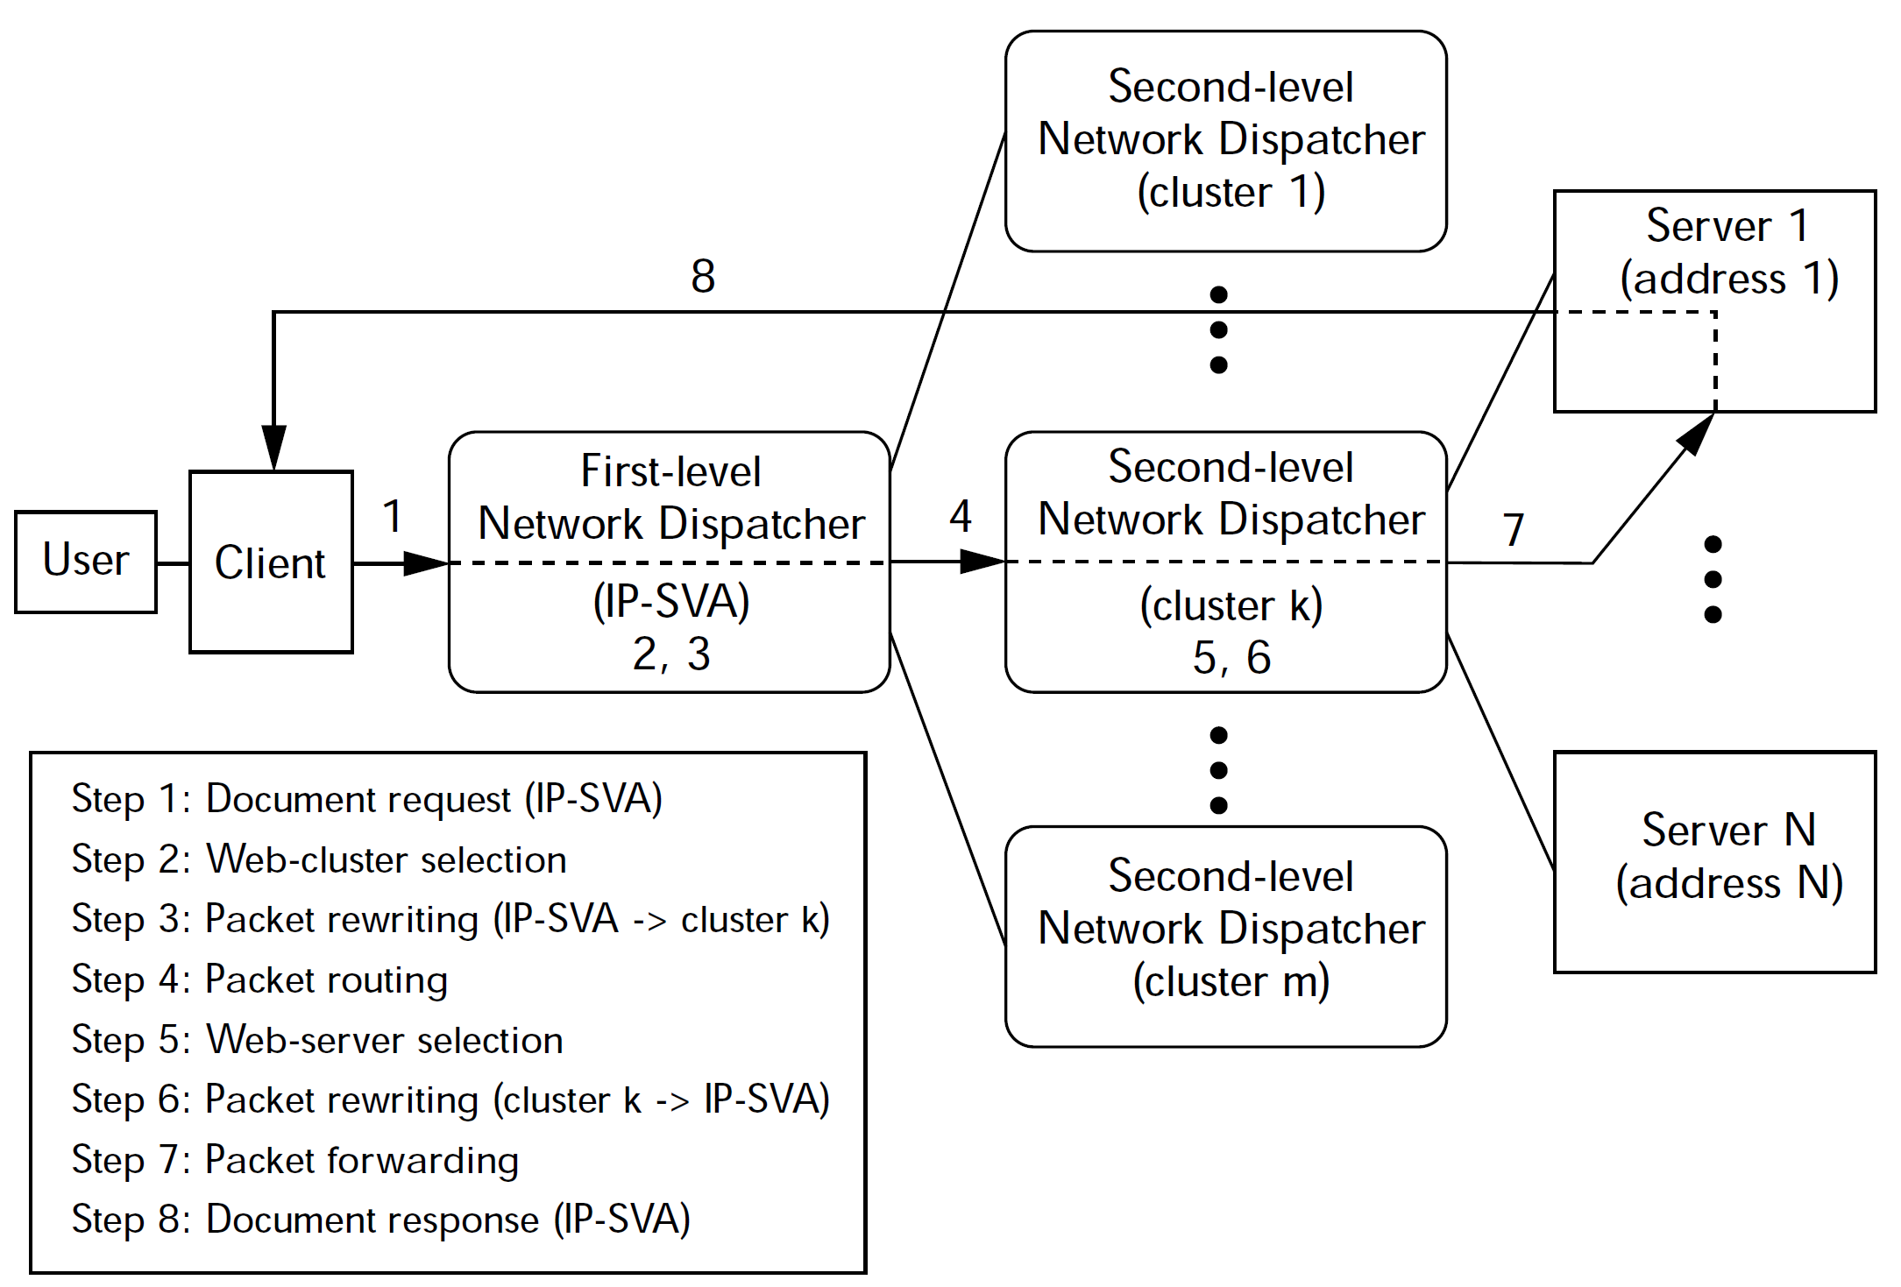
WAN Network Dispatcher Architecture

Slide 19
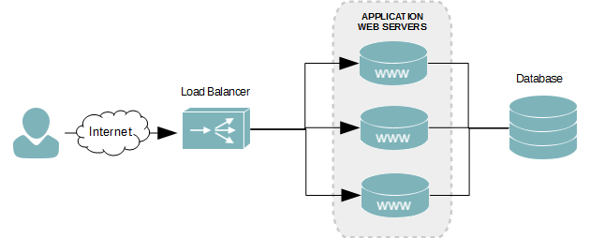
Hardware Load Balancers
Specialized routers or switches.
https://www.cisco.com/c/en/us/products/switches/index.html
https://www.barracuda.com/products/loadbalancer

Slide 20
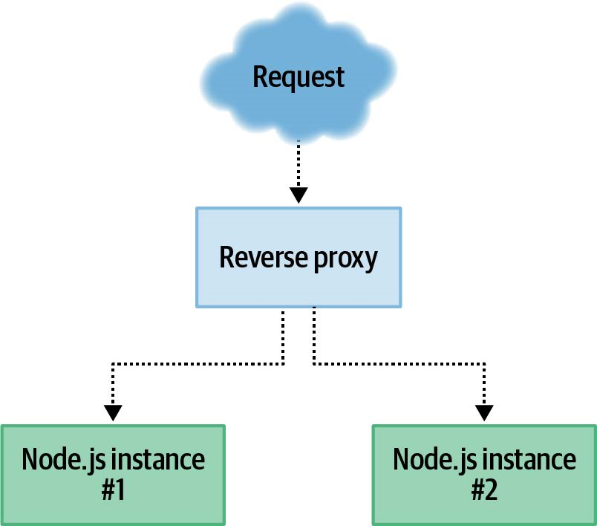
Software Load Balancers
https://docs.nginx.com/nginx/admin-guide/load-balancer/http-load-balancer/ (HTTP load balancer with SSL termination support)
https://www.haproxy.org/ (TCP load balancer)

Slide 21
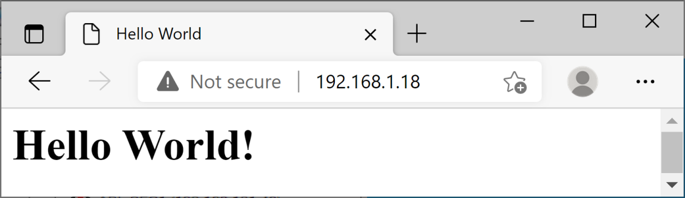
1. Install Nginx
Refer to Computer Networks → 04.6. HTTP Services.pptx for detail.
Test Nginx default website
http://192.168.1.18

Slide 22
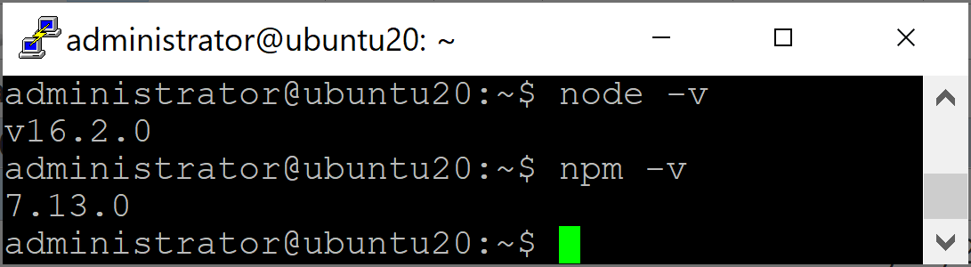
2. Install Node.js
Refer to Web Application Development → 10. Node.js.pptx for detail.

Slide 23
3. Create 1st Node.js Web Application
mkdir lbweb1
cd lbweb1
npm init -y
sudo nano index.js
const port = 3001,
http = require("http"),
httpStatus = require("http-status-codes"),
app = http.createServer((request, response) => {
console.log("Received an incoming request!");
response.writeHead(httpStatus.OK, {
"Content-Type": "text/html"
});
let responseMessage = `<h1>Hello World from ${port}!</h1>`;
response.write(responseMessage);
response.end();
console.log(`Sent a response : ${responseMessage}`);
});
app.listen(port);
console.log(`The server has started and is listening on port number: ${port}`);

Slide 24
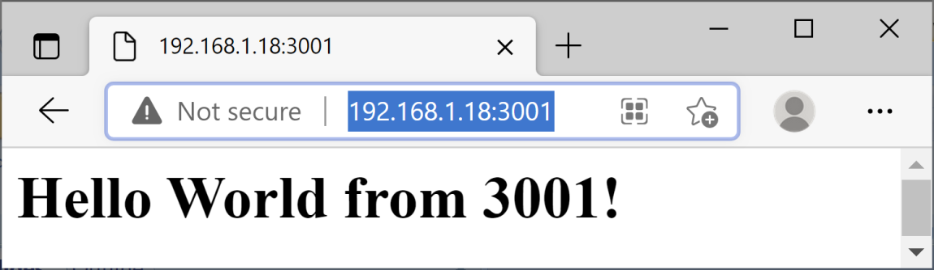
4. Run 1st Node.js Web Application
npm install http-status-codes
node index.js
http://192.168.1.18:3001

Slide 25
5. Create 2nd Node.js Web Application
mkdir lbweb2
cd lbweb2
npm init -y
sudo nano index.js
const port = 3002,
http = require("http"),
httpStatus = require("http-status-codes"),
app = http.createServer((request, response) => {
console.log("Received an incoming request!");
response.writeHead(httpStatus.OK, {
"Content-Type": "text/html"
});
let responseMessage = `<h1>Hello World from ${port}!</h1>`;
response.write(responseMessage);
response.end();
console.log(`Sent a response : ${responseMessage}`);
});
app.listen(port);
console.log(`The server has started and is listening on port number: ${port}`);

Slide 26
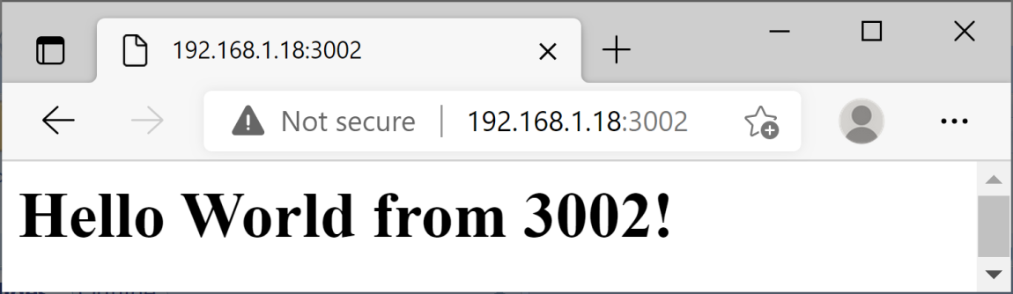
6. Run 2nd Node.js Web Application
npm install http-status-codes
node index.js
http://192.168.1.18:3002

Slide 27
7. Pass Requests to a Proxied Server
sudo nano /etc/nginx/sites-available/default
server {
...
location / {
proxy_pass http://192.168.1.18:3001/;
}
}
sudo nginx -t
sudo service nginx reload

Slide 28
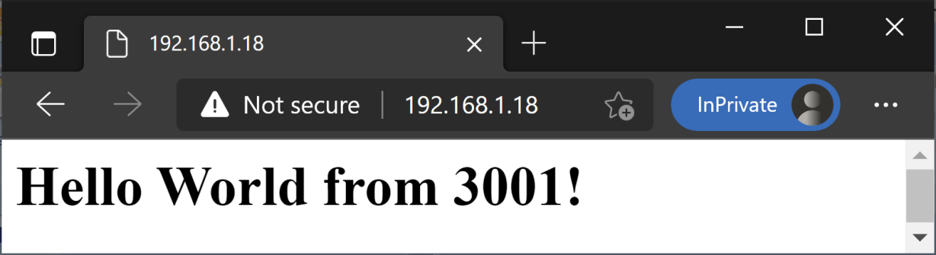
8. Test Passing Requests
http://192.168.1.18

Slide 29
9. Implement Load Balancing
sudo nano /etc/nginx/sites-available/default
upstream lbweb {
server 192.168.1.19:3000 weight=1;
server 192.168.1.19:3001 weight=2;
}
server {
...
location / {
proxy_pass http://lbweb/;
}
}
sudo nginx -t
sudo service nginx reload

Slide 30

10. Test Load Balancing
http://192.168.1.18 (Use private browsing to prevent potential cache).
http://192.168.1.18

Slide 32
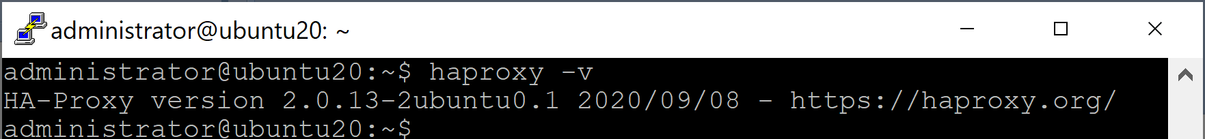
1. Install haproxy on Ubuntu
sudo apt install haproxy
haproxy -v

Slide 33
Build from Source in Ubuntu
sudo apt install libssl-dev
sudo apt-get install zlib1g-dev
curl -O https://www.haproxy.org/download/2.4/src/haproxy-2.4.0.tar.gz
tar -xf haproxy-2.4.0.tar.gz
cd haproxy-2.4.0
make -j4 TARGET=linux-glibc USE_ZLIB=yes USE_OPENSSL=yes
sudo make install
haproxy -v

Slide 34
2. Start haproxy
mkdir haproxy
cd haproxy
sudo nano stats.cfg
haproxy -f stats.cfg
frontend inbound
mode http
bind localhost:8000
stats enable
stats uri /admin?stats

Slide 35
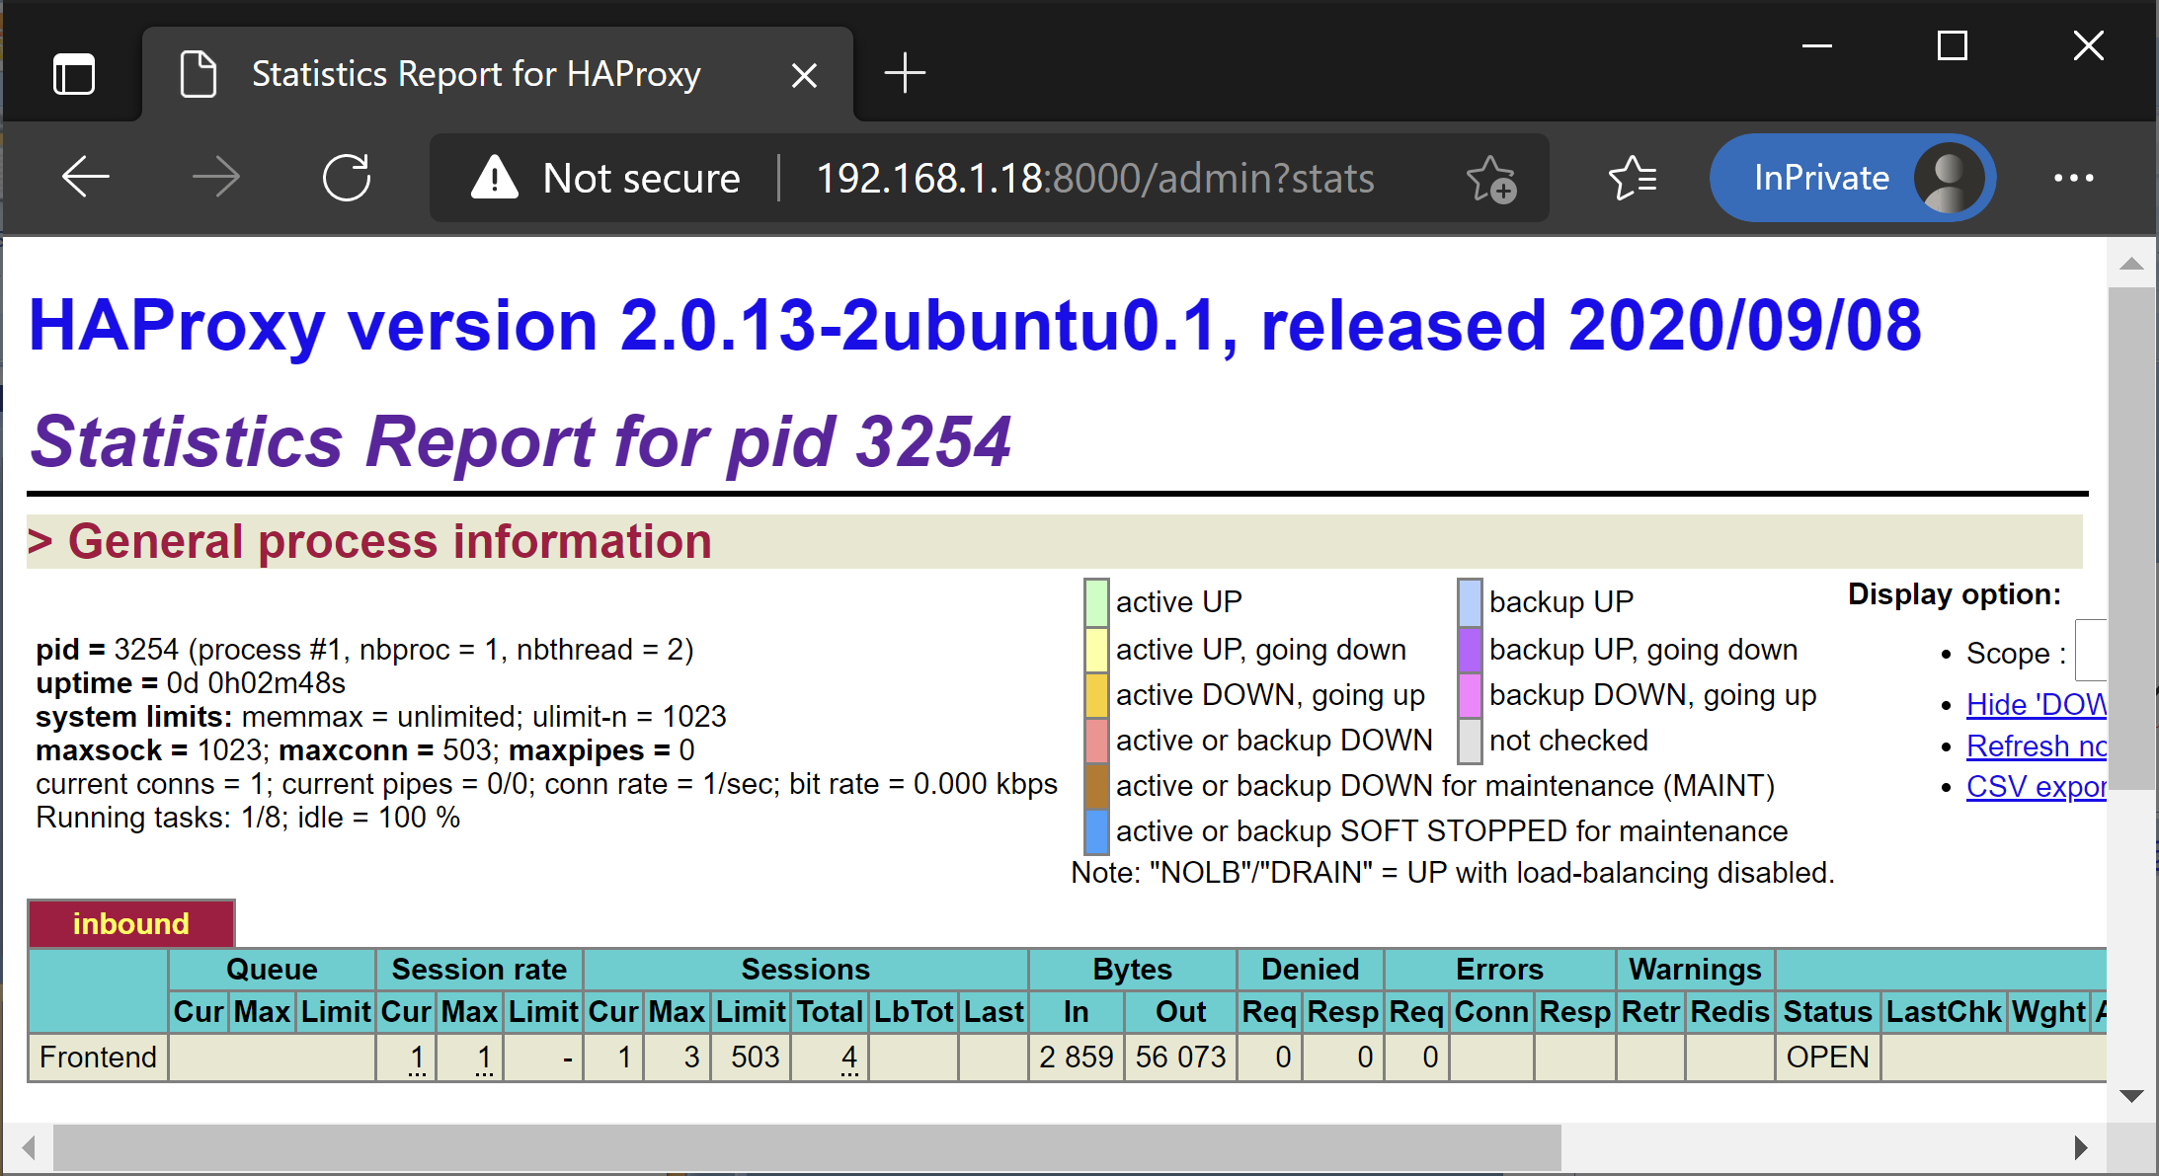
3. Test haproxy
http://192.168.1.18:8000/admin?stats

Slide 36
4. Implement Load Balancing
mkdir haproxy
cd haproxy
sudo nano load-balance.cfg
haproxy -f load-balance.cfg
defaults
mode http
timeout connect 5000ms
timeout client 50000ms
timeout server 50000ms
frontend inbound
bind 192.168.1.18:8000
default_backend lbweb
stats enable
stats uri /admin?stats
backend lbweb
option httpchk GET /health
server lbweb1 192.168.1.18:3001 check
server lbweb2 192.168.1.18:3002 check

Slide 37
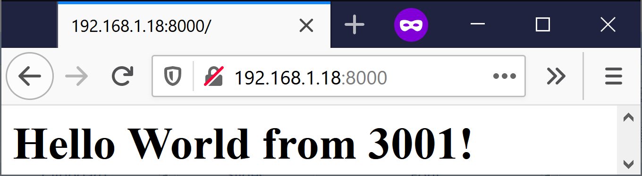
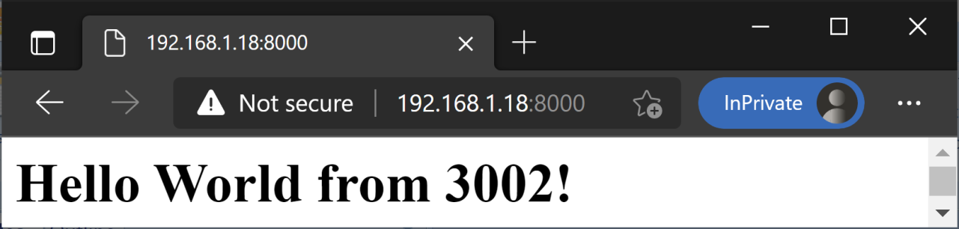
5. Test Load Balancing
http://192.168.1.18:8000 (Use private browsing of different browsers to prevent potential cache).
http://192.168.1.18

Slide 38
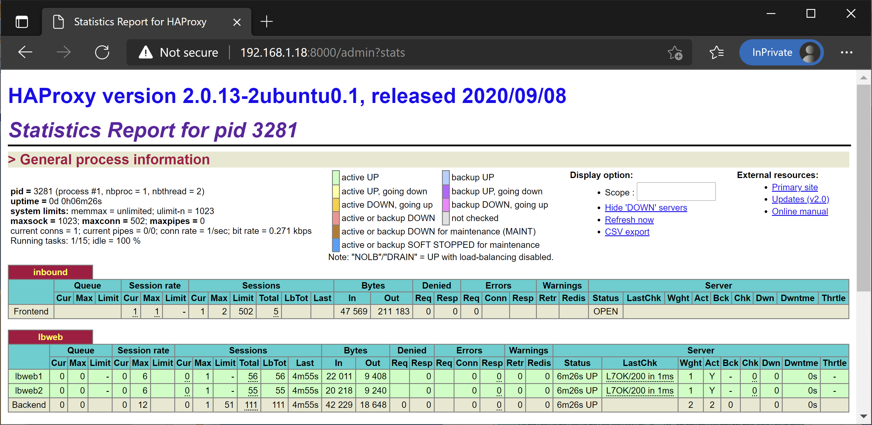
6. Review haproxy Reports
http://192.168.1.18:8000/admin?stats

Slide 40
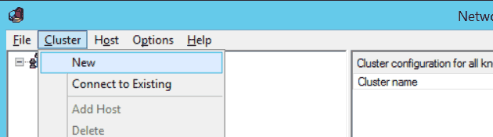
Windows Network Load Balancing
http://www.serverlab.ca/tutorials/windows/web-servers/load-balancing-web-servers-with-windows-server-2012-r2/
Launch the Network Load Balancing Manager. This can be done by clicking the Tools menu in the Server Manager.
From the top menu of the Network Load Balancing Manager, click Cluster, and then click New.
Sticky sessions.

Slide 42
Load Balancing Algorithms
https://www.youtube.com/watch?v=kpvbOzHUakA
Round Robin
Weighted Round Robin
Random
Consistent Hashing
Least Connections / Least Requests
Power-of-Two Choices (common in large-scale RPC systems)

Slide 43
Sticky Routing Algorithms
Select backend via hash of request attributes.
Source IP hash
5-tuple hash (source IP address, destination IP address, source port, destination port, protocol (e.g., TCP, UDP))
URL hash
Header/cookie hash
Consistent hashing
Rendezvous (Highest Random Weight) hashing
Maglev hashing

Slide 44
More about Algorithms
https://www.youtube.com/watch?v=6NdxUY1La2I

Slide 45
The Tail at Scale
If:
Each subrequest has 1% probability of being slow (p99 event),
A page requires 100 parallel subrequests,
Then:
P(at least one slow) ≈ 1 − (0.99)¹⁰⁰ ≈ 63%
So even if each component is “99% fast,” the overall request is slow most of the time.
This is why tail latency dominates user experience at scale.

Slide 46
Tail Latency
Instead of asking:
"What is the average latency?"
tail latency asks:
"How slow are the slowest 1% (or 0.1%) of requests?"
The p-th percentile latency is the value t_{p}​ such that:
P( T ≤ t_{p} ) = p
p99 latency: 99% of requests complete faster than this value.
p99.9 latency: 99.9% complete faster.
Tail latency is the latency experienced by the slowest fraction of requests in a system, typically measured at high percentiles (p95, p99, p99.9). Mathematically precise: right-tail latency.

Slide 47
p99 = 10 ms Meaning
p99 = 10 ms means the 99th percentile latency is 10 milliseconds.
In practical terms, if you measure 10,000 requests and sort them from fastest to slowest:
About 9,900 requests finish in 10 ms or less.
About 100 requests take longer than 10 ms.
One important nuance is that p99 = 10 ms does not mean the slowest request takes 10 ms. The maximum could be 20 ms, 500 ms, or several seconds.

Slide 48
Practical Implication
Set an SLO (Service Level Objective): "99% of requests must complete within 10 ms."
Detect regressions: If a new release changes p99 from 10 ms to 25 ms while p50 stays at 3 ms, the release probably introduced a tail-latency problem.
Create alerts: Alert when p99 exceeds, say, 15 ms for a sustained period.
Compare implementations: Version A has p99 = 10 ms and Version B has p99 = 18 ms, so A gives more predictable latency.
Test capacity: Run load tests at 1,000, 5,000, and 10,000 requests/sec and observe when p99 begins increasing sharply.

Slide 49
Tail-tolerant Techniques [2]
Hedged requests. A simple way to curb latency variability is to issue the same request to multiple replicas and use the results from whichever replica responds first.
Micro-partitions. To combat imbalance, many of Google’s systems generate many more partitions than there are machines in the service, then do dynamic assignment and load balancing of these partitions to particular machines.
Selective replication. An enhancement of the micro-partitioning scheme is to detect or even predict certain items that are likely to cause load imbalance and create additional replicas of these items.

Slide 51
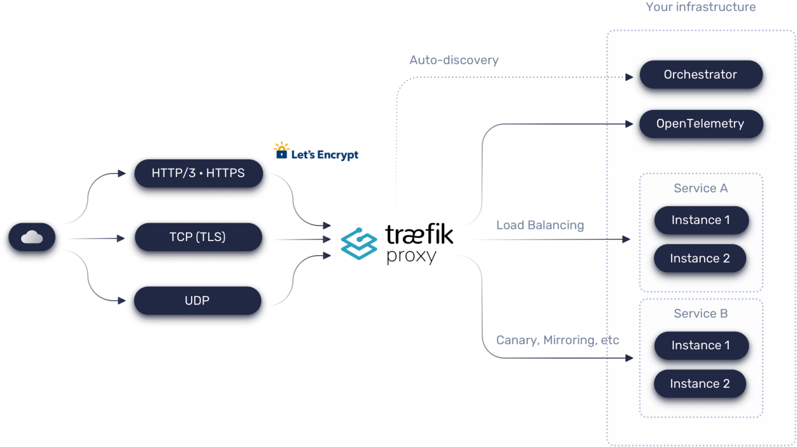
Traefik
https://traefik.io/traefik
Unlike a traditional reverse proxy, which requires manual configuration, Traefik uses service discovery to dynamically configure routing.

Slide 53
Further Reading
David G. Thaler and Chinya V. Ravishankar (1998). Using Name-Based Mappings to Increase Hit Rates.
Load Balancing Algorithms

Slide 54

Thank You & See You Again

